Slide 1
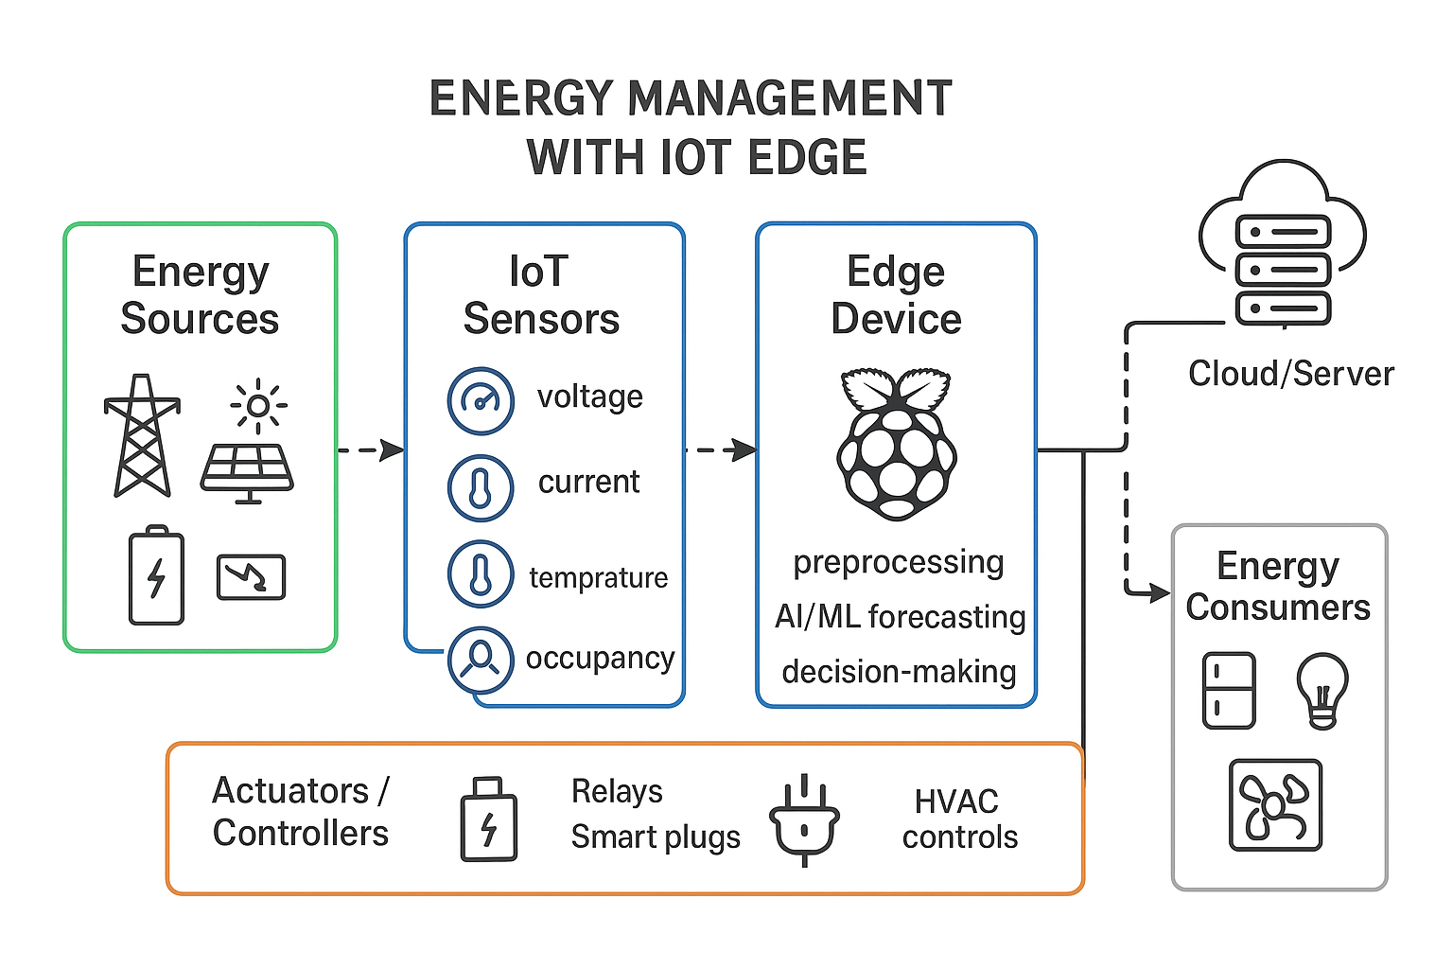
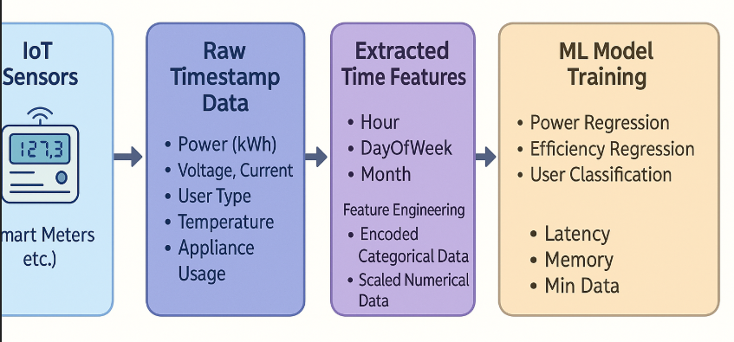
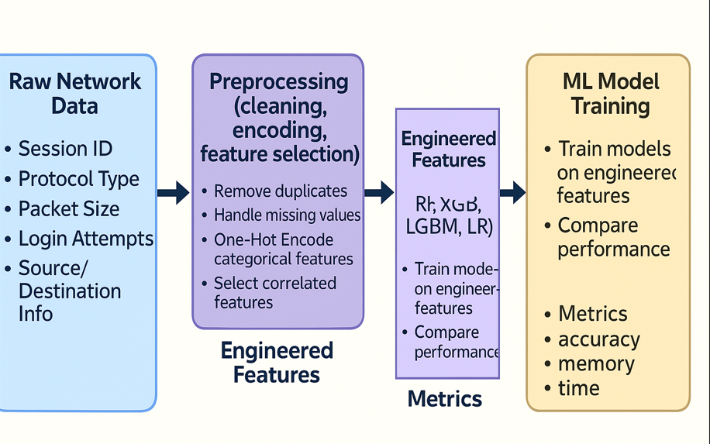
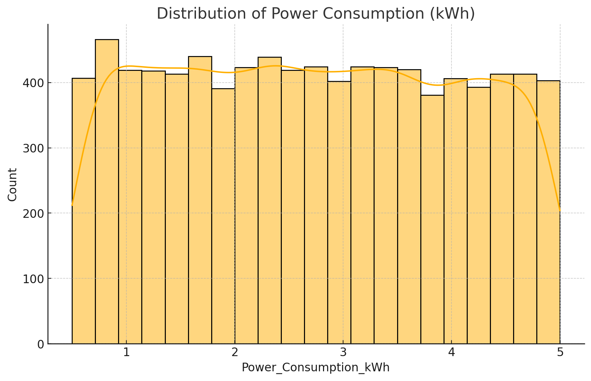
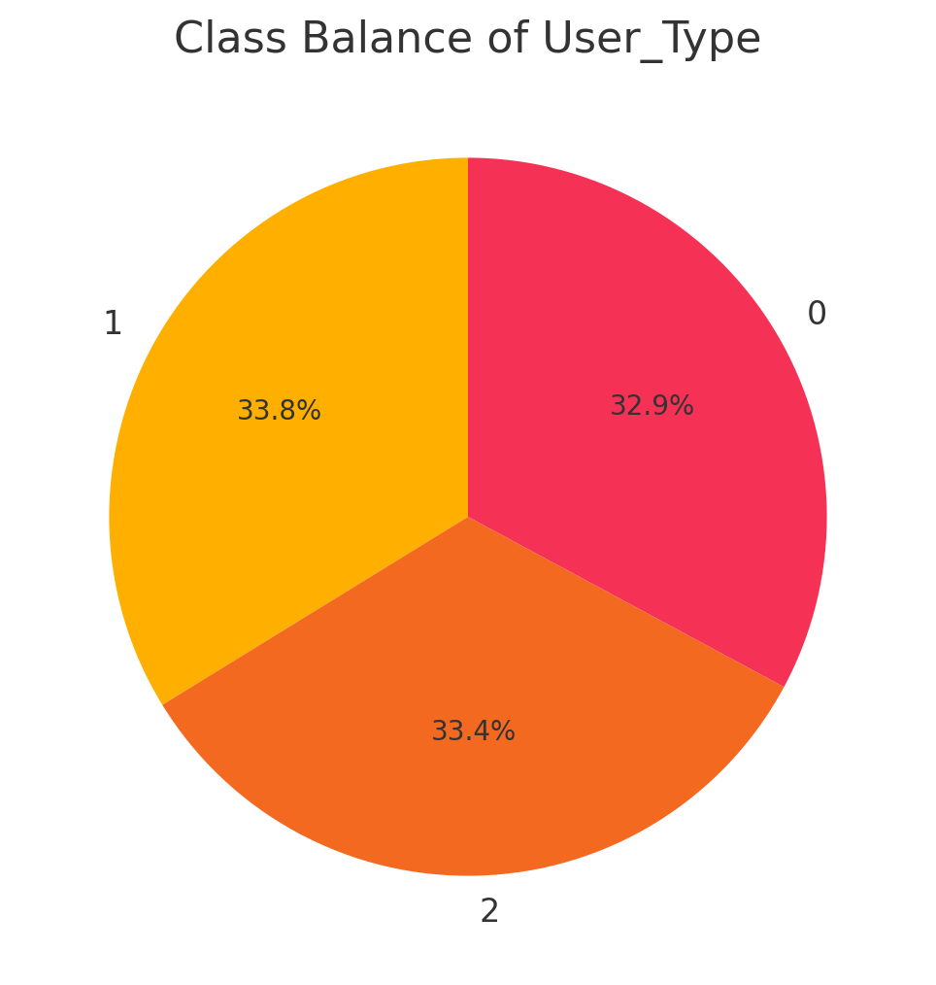
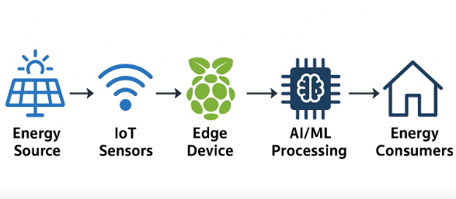
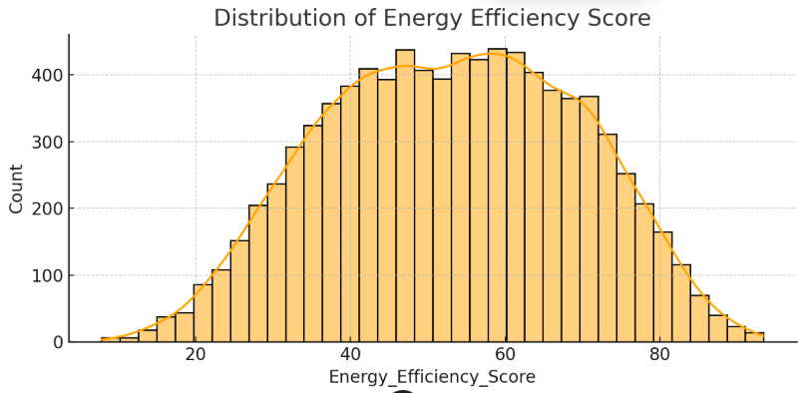
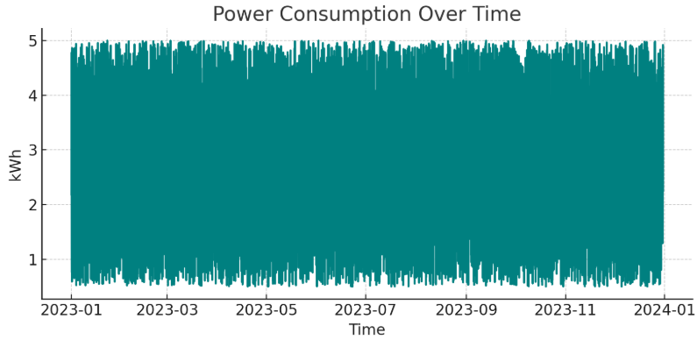
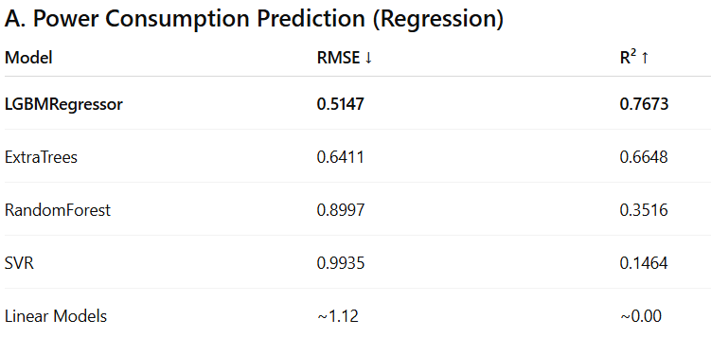
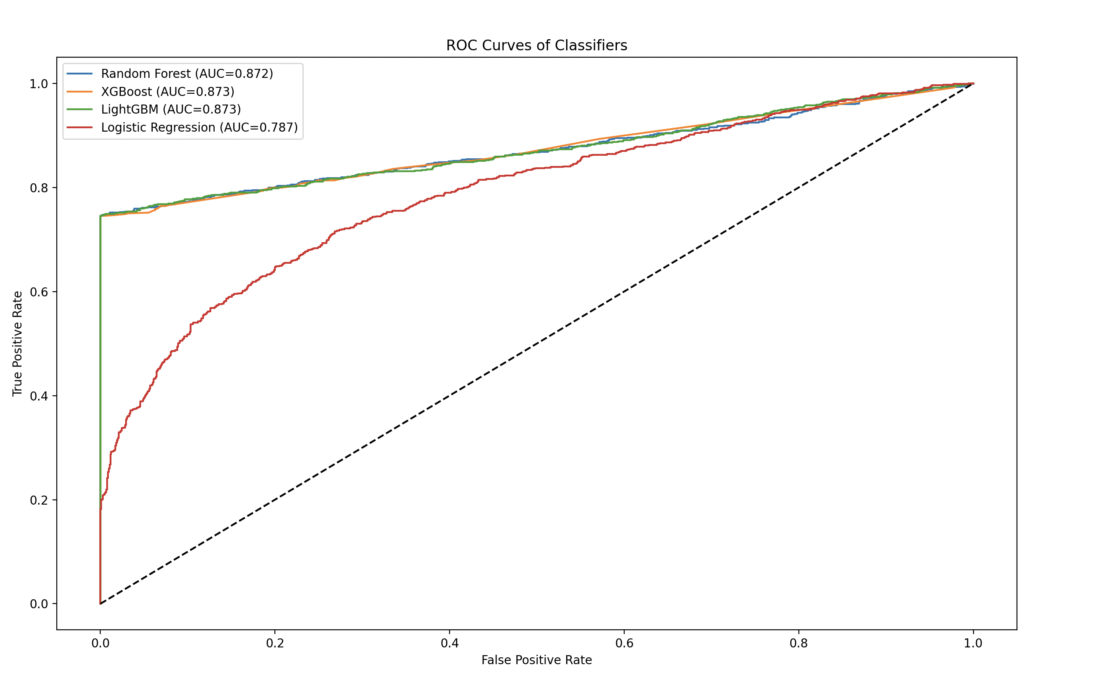
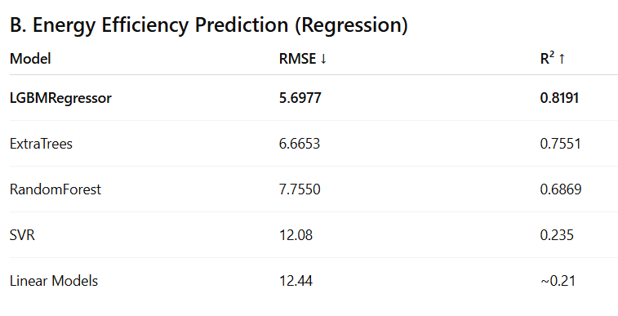
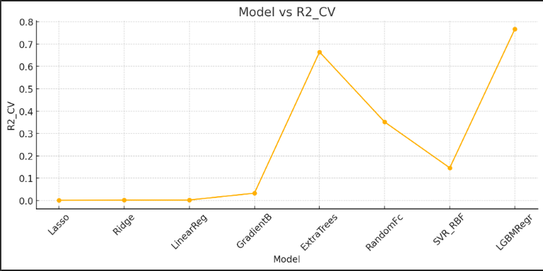
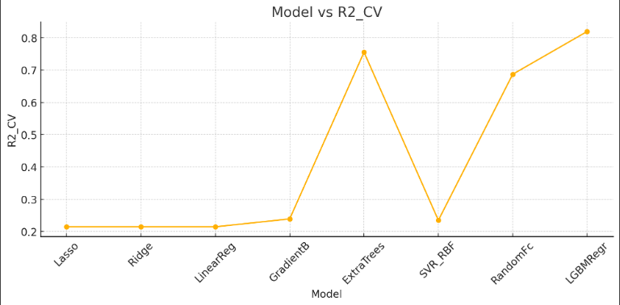
Edge AI
Smart Energy Management
Intrusion Detection System
Methodology
Objective: Evaluate ML models for three key tasks: power consumption prediction, energy efficiency estimation, and user-type classification.
Dataset: Smart grid IIoT sensor data (8,737 rows) capturing hourly electrical (Voltage, Current) and environmental parameters.
The Threat: AMI networks are vulnerable to attacks where hackers inject false data (e.g., modifying readings to show low consumption), leading to revenue loss.
Edge Defence: Deploying an Anomaly-Based IDS at the edge enables distributed defence, where each meter can stop compromised nodes, thereby reducing the load on the central utility.
Key Features: Analysis of network traffic identified failed_logins (highest correlation), protocol_type (UDP is most vulnerable), and browser_type as critical indicators of attack.
Block Diagram
Schematic Diagram of Dataset
Edge AI is the integration of AI with edge computing, enabling data preprocessing and decision-making to happen on devices close to the source of data rather than relying on centralised cloud servers.
Key Benefits:
Reduced Latency: Enables real-time decision making.
Privacy: Keeps sensitive usage data local.
Reliability: Functions even with unstable internet
Schematic Diagram of Dataset:
Preprocessing and EDA of Dataset:
Preprocessing:
Feature Engineering: Extracted hour, day, and month from timestamps to capture temporal patterns.
Encoding & Scaling: Applied One-Hot Encoding for categorical data (e.g., Weather) and StandardScaler for numerical features.
Results:
Model | Accuracy | F1 Score | ROC-AUC | Training Time (sec) | Peak Memory (MB) | Est. Min Data Points
Random Forest | 0.8857 | 0.8535 | 0.8716 | 8.26 | 2.60 | 18000
XGBoost | 0.8863 | 0.8543 | 0.8726 | 0.83 | 2.32 | 9000
LightGBM | 0.8863 | 0.8543 | 0.8727 | 20.65 | 4.33 | 18000
Logistic Regression | 0.7301 | 0.6827 | 0.7873 | 0.27 | 2.26 | 90
Performance Comparison of ML Models for Network Intrusion Detection
Advanced Metering Infrastructure (AMI) enables two-way communication between utilities and customers but relies on public networks, exposing smart meters to cyber threats like False Data Injection.
Edge AI Solution: We propose running AI models directly on edge devices (e.g., gateways/meters) rather than the cloud. This ensures real-time decision-making, reduces latency, and secures data privacy.
Results:
Observations From Results:
Regression Tasks (Power & Efficiency)
Linear models failed → clear non-linear patterns
Boosting models (LightGBM, GBM) consistently outperformed all others
Extra Trees ranked second → strong ensemble behaviour
LightGBM achieved best RMSE & R² across both tasks
IDS Role: A lightweight Intrusion Detection System (IDS) at the edge is critical to detect anomalies in resource-constrained smart meters before damage spreads.
ROC-AUC Curve
Path for AMI and IDS in Edge AI

